Slide 1
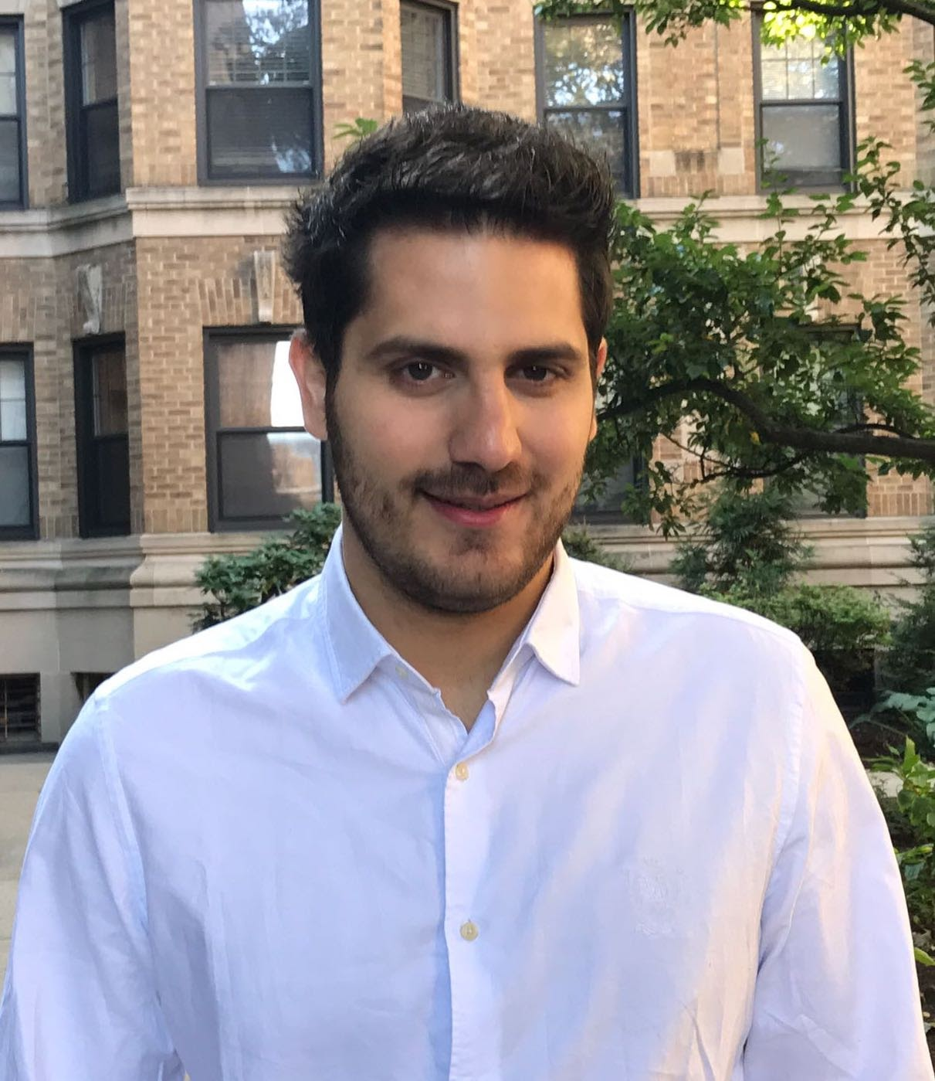
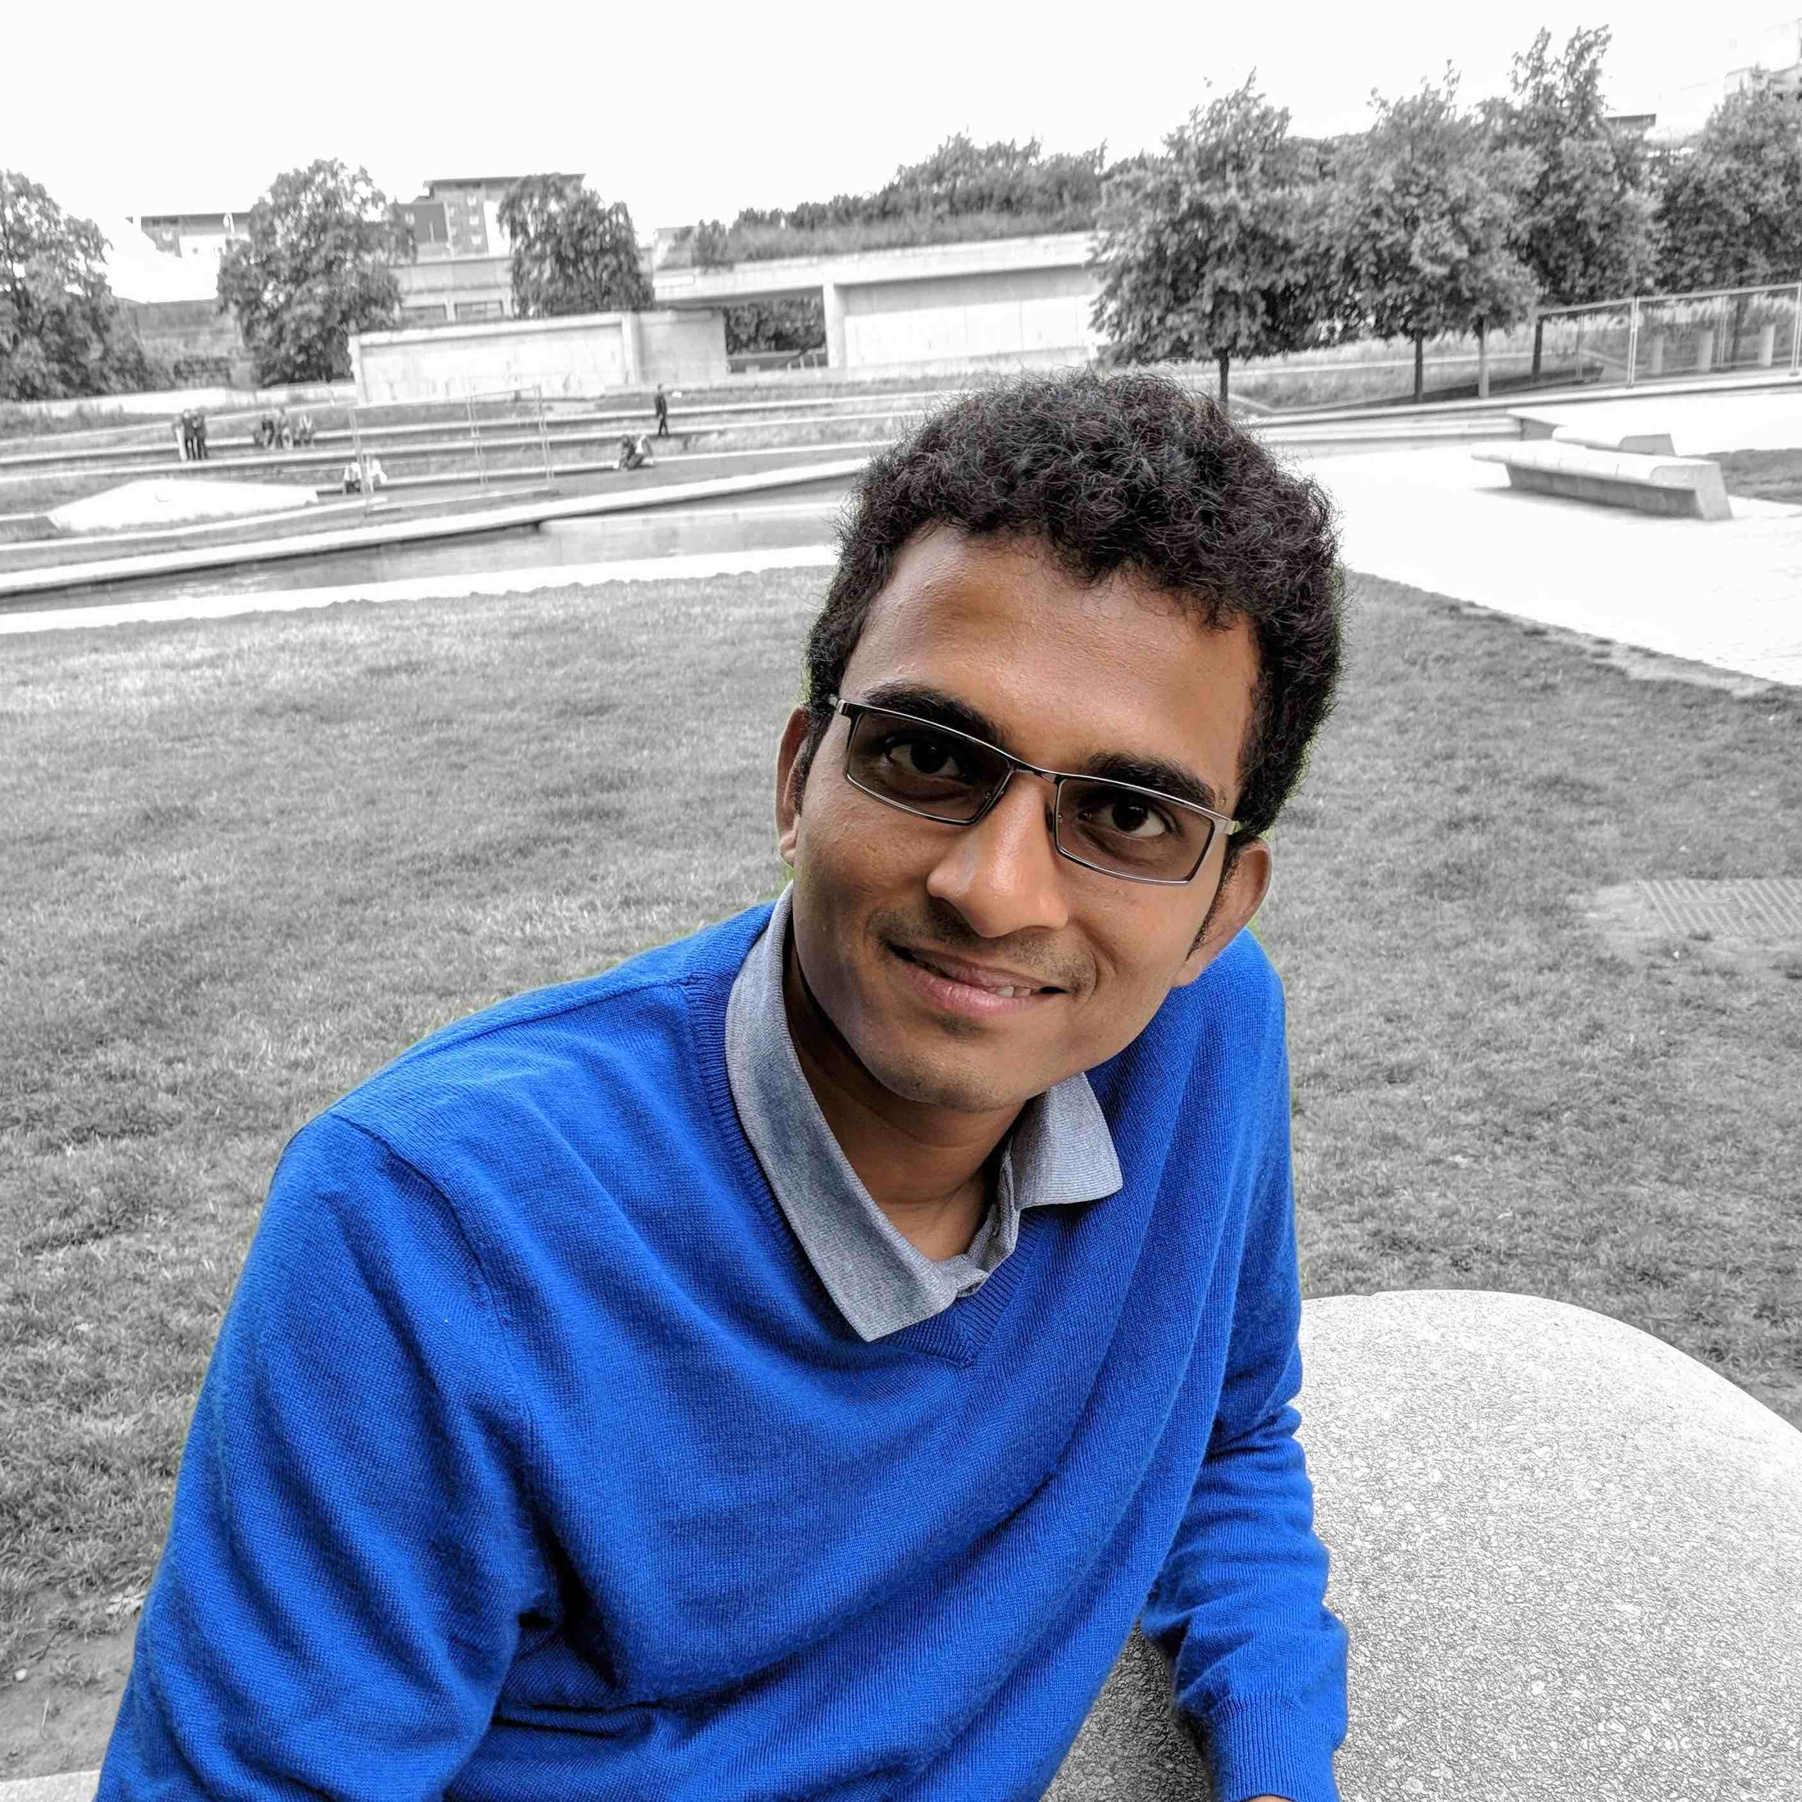
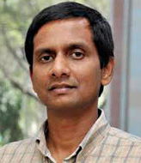
On Differentially Private Counting on Trees
Kewen Wu (UC Berkeley)
Badih Ghazi
Pritish Kamath
Ravi Kumar
Pasin Manurangsi
Google Mountain View
Google Thailand

Slide 2
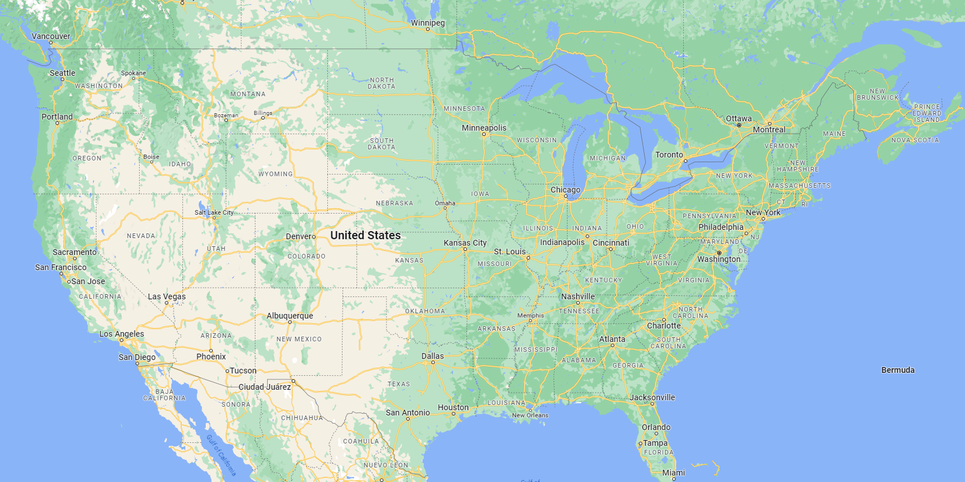
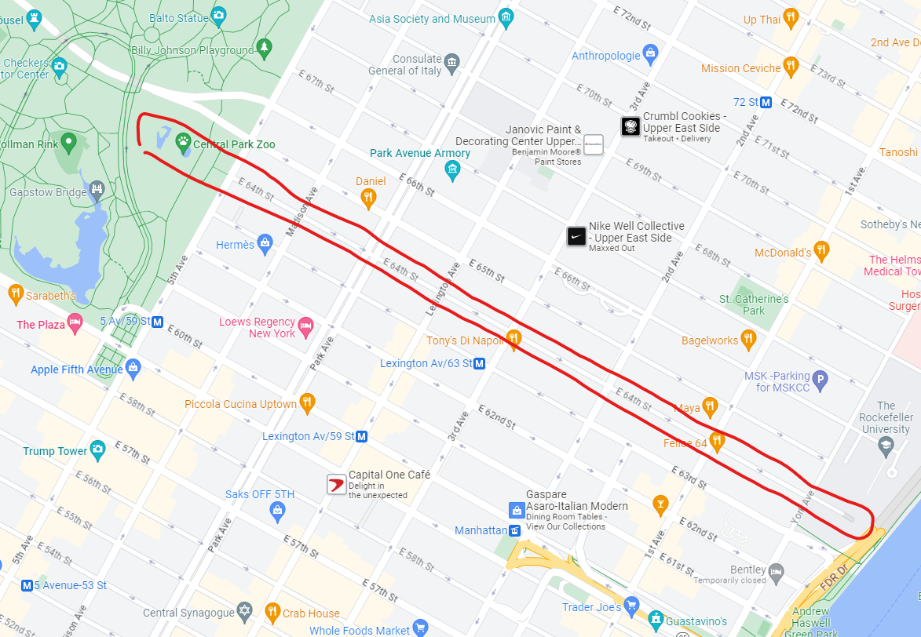
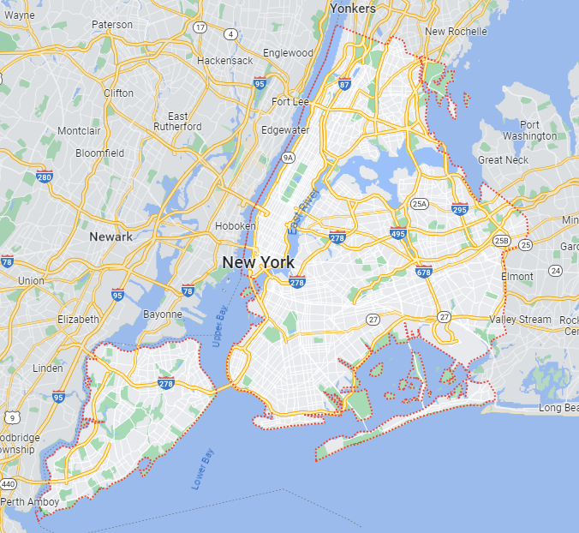
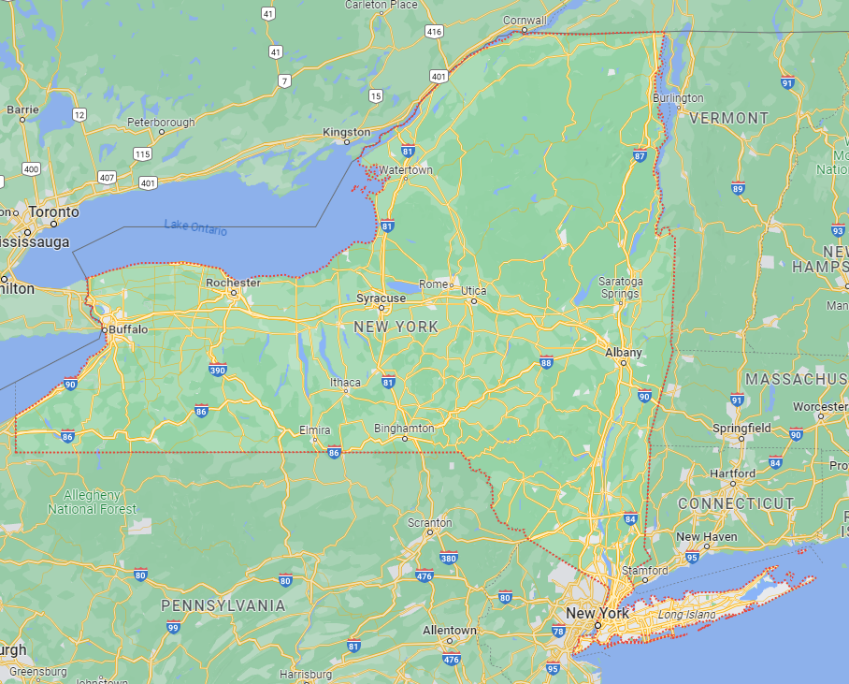
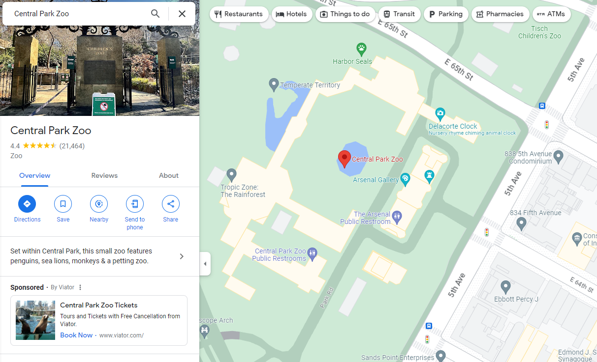
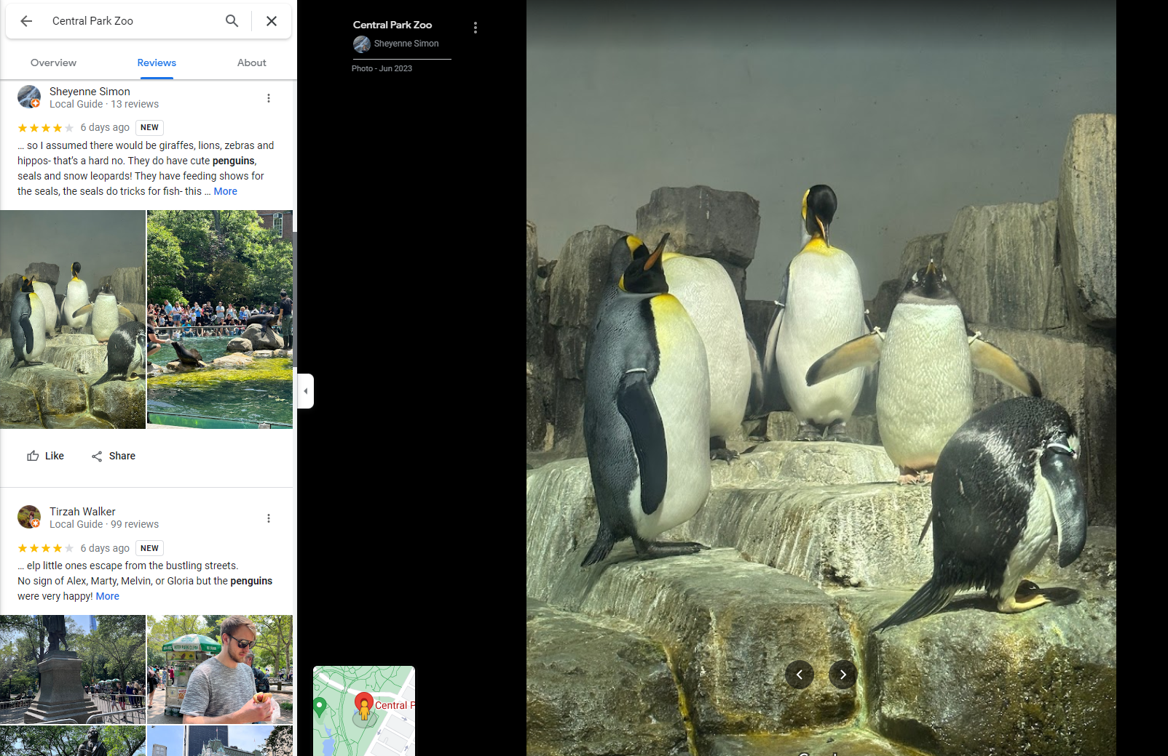
Census: How many penguins live in Central Park Zoo of NY?
Country: US
Street: East 64th
Specie: Penguin
State: New York
Facility: Central Park Zoo
Yes, the story of Madagascar happened in this zoo.
And there is no penguin in Madagascar.
City: New York

Slide 3
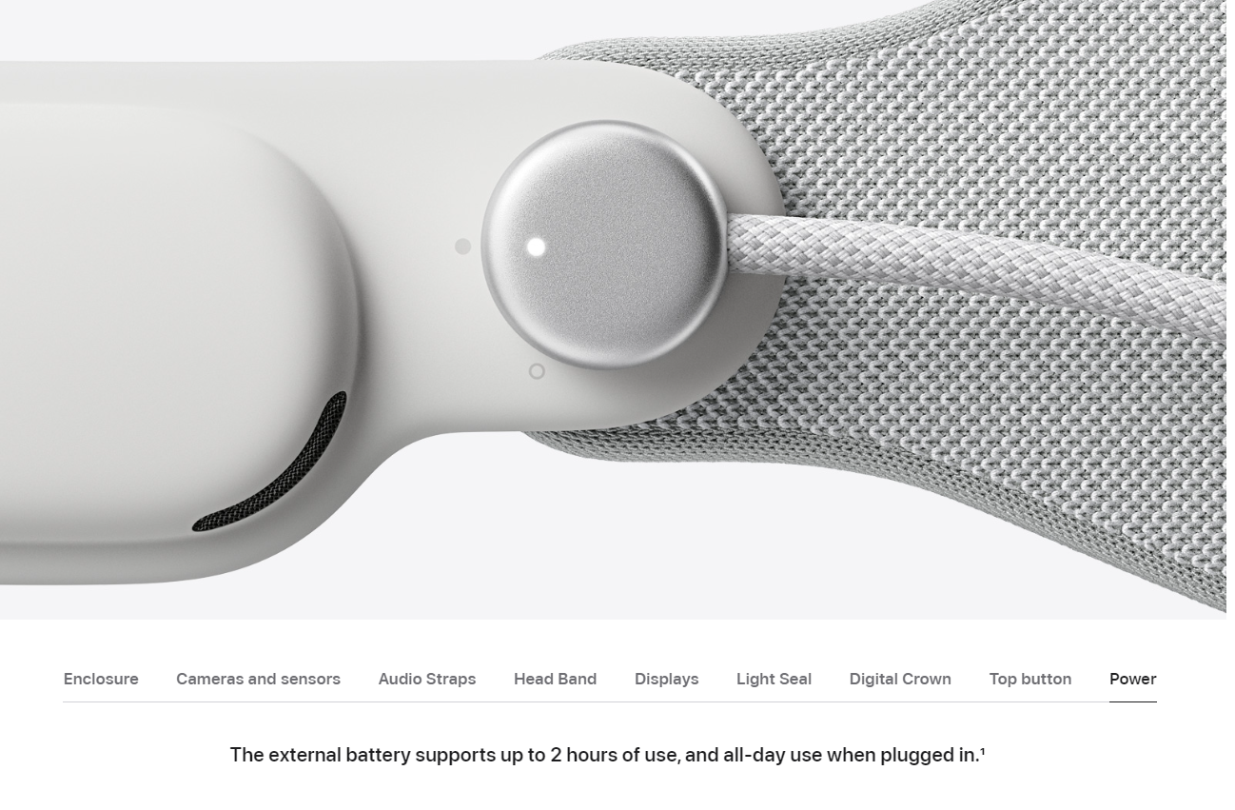
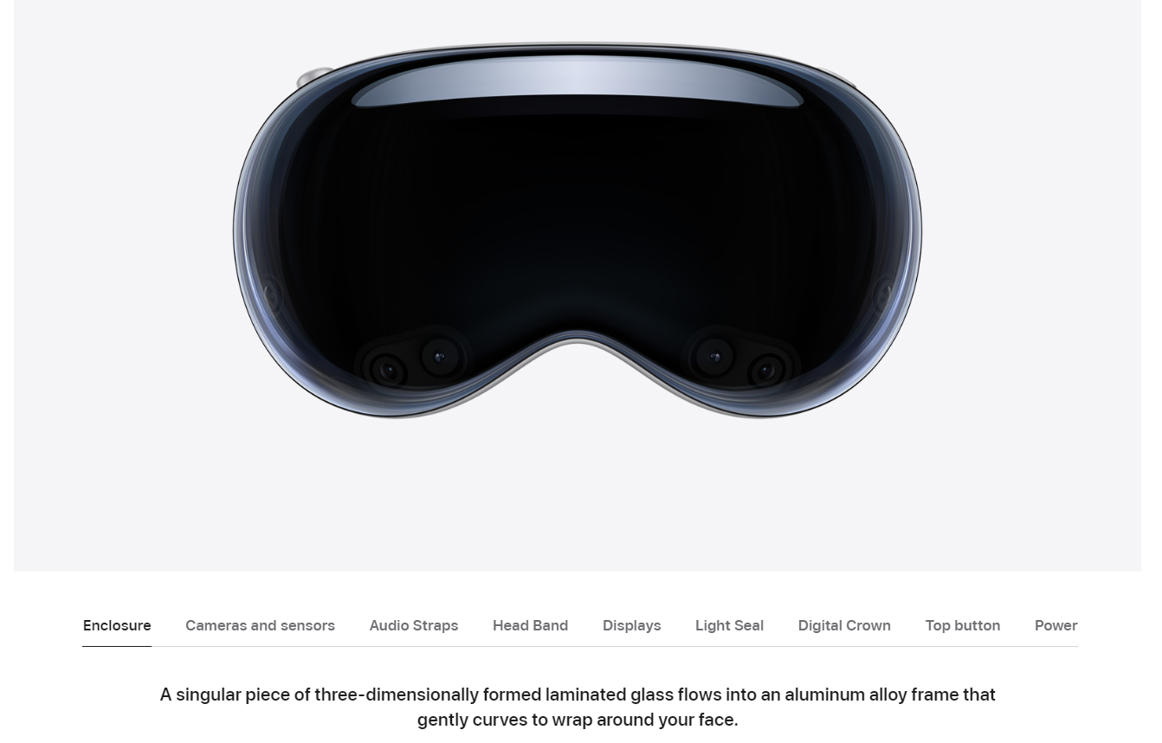
Ads:
Do people care more about Vision Pro or the new Mac?
Are people interested more in battery supports than display resolution?

Slide 4
Counting on Tree
$N$ = # Leaves
42
$d$ = Tree depth
9
33
Node query $i$:
$q_{i}$ = total of $x_{ℓ}$ for all leaves $ℓ$ under $v_{i}$
4
5
16
17
Captures:
Census (Geographical hierarchy)
Ads (Webpage hierarchy)
……
Input: length-$N$ positive vector $x$

Slide 5
Accuracy
Queries $q1, …, q_{m}$
Answers $a_{1}, …, am$
How many people live in US?
How many people live in California, US?
How many people live in Berkeley, California, US?
How many people live in 42 Euclidean St, Berkeley, California, US?
How many people live in 42 Euclidean St Apt A, Berkeley, California, US?
Are they students? Gender? Age?
Boundary Cases:
$α=0$: $err_{α}=err$
$α≥1$: $err_{α}=0$ by $a_{i}≡0$
Additive & Multiplicative Error
Additive-Only Error
$α$ : multiplicative factor
$$err(ai) =\sqrt{E\left[{\left(a_{i}−q_{i}\right)}^{2}\right]}$$
$${err}_{α}(ai) =\sqrt{E\left[{\max{(\left|a_{i}−q_{i}\right|−αq_{i},0)}}^{2}\right]}$$
$$err=\max_{i}{err(e_{i})}$$
$${err}_{α}=\max_{i}{{err}_{α}(ai)}$$

Slide 6
Differential Privacy (DP) [Dwork-Kenthapadi-McSherry-Mironov-Naor’06]
The output of the algorithm is probabilistic and not sensitive to small perturbations to the input
$⇒$ We cannot infer much about the input using the output
$⇒$ Private
$(ε,δ)$-DP: For any neighboring input $x,y$ and any measurable set $S$
$$\operatorname{Pr}\left[A\left(x\right)∈S\right]≤e^{ε}\operatorname{Pr}\left[A\left(y\right)∈S\right]+δ$$
$x,y$ are neighbors $⇔|x−y|_{1}=1$
$δ=0$: Pure-DP
$δ∈\left(0,1\right)$: Approximate-DP
$δ≥1$: Trivial

Slide 7
Goal
Design an algorithm $A$ for the counting task on a depth-$d$ tree
Output a vector that is approximately correct under the error metric
Additive & multiplicative error $err_{α}$
$A$ should be $(ε,δ)$-DP and efficient
Smaller $err_{α}$ $⇒$ More accurate
Smaller $ε,δ$ $⇒$ More private
Fix $ε,δ,d,α$. What is the smallest possible $err_{α}$?

Slide 8
Results
Error / Privacy | Pure-DP $$δ=0$$ | Approximate-DP $$δ∈(0,1)$$
Additive only $$α=0$$ | $O\left(d/ε\right)$ [Laplace Mechanism] | $$O\left(\sqrt{d\log{(1/δ)}}/ε\right)$$ [Gaussian Mechanism]
 | $$Ω\left(d/ε\right)$$ [Our result] | $$Ω_{ε,δ}\left(\sqrt{d}\right)$$ [Edmonds-Nikolov-Ullman’20]
Multiplicative & additive $α∈\left(0,1\right)$ is a constant | $$Ω\left(d/ε\right)$$ [Our result] | $$O\left(\log{(d/δ)}/ε\right)$$ [Our result]
Simple mechanisms work best
Tight even when we allow multiplicative error
Exponential improvement when we allow multiplicative error
Remark: Lower bounds are proved for binary trees. Upper bounds hold for arbitrary trees.

Slide 9
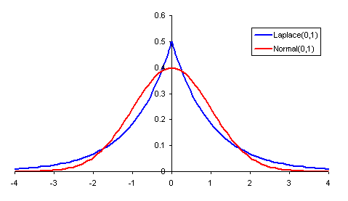
Laplace / Gaussian Mechanism [Dwork-Kenthapadi-McSherry-Mironov-Naor’06, Dwork-Roth’16]
$$Lap\left(b\right)∝e^{−x/b}$$
$$Lap(1)$$
Adding independent Laplace noise $Lap\left(d/ε\right)$ to each query satisfies $ε$-DP
$$N(0,1)$$
Adding independent Gaussian noise $N\left(0,d\log\left(1/δ\right)/ε^{2}\right)$ to each query satisfies $(ε,δ)$-DP
42
39.1
$$N\left(0,σ^{2}\right)∝e^{−x^{2}/2σ^{2}}$$
9
33
Add noise
10.2
36.7
4
5
16
17
2.9
4.2
10.9
19.1

Slide 10
Results
Error / Privacy | Pure-DP $$δ=0$$ | Approximate-DP $$δ∈(0,1)$$
Additive only $$α=0$$ | $O\left(d/ε\right)$ [Laplace Mechanism] | $$O\left(\sqrt{d\log{(1/δ)}}/ε\right)$$ [Gaussian Mechanism]
 | $$Ω\left(d/ε\right)$$ [Our result] | $$Ω_{ε,δ}\left(\sqrt{d}\right)$$ [Edmonds-Nikolov-Ullman’20]
Multiplicative & additive $α∈\left(0,1\right)$ is a constant | $$Ω\left(d/ε\right)$$ [Our result] | $$O\left(\log{(d/δ)}/ε\right)$$ [Our result]

Slide 11
Reduction to Classification
Classification Problem
Given threshold $τ$
Output for each node $v$ whether
$q_{v}$ is above $\left(1+α\right)τ$ or below $\left(1−α\right)τ$
If $q_{v}∈[\left(1−α\right)τ,\left(1+α\right)τ]$, any answer works
Example: $τ=30, α=0.2$
Above: $≥36$
Below: $≤24$
Arbitrary: $24\sim 36$
If the classification algorithm is private, the reduction result is also private
42
9
37
Reduction
Run classification on geometrically decreasing $τ$
Tracking privacy loss and error accumulation
Use the smallest $τ$ it is above threshold as estimate
4
5
25
12

Slide 12
Reduction Example
$$τ=35, α=0.2$$
Above: $≥42$Below: $≤28$
42
9
37
4
5
25
12
42
42
$$τ=25, α=0.2$$
Above: $≥30$Below: $≤20$
9
37
4
5
25
12
6
30
42
$$τ=15, α=0.2$$
Above: $≥18$Below: $≤12$
9
37
0
0
18
6
4
5
25
12
42
$$τ=5, α=0.2$$
Above: $≥6$Below: $≤4$
9
37
4
5
25
12

Slide 13
Classification Algorithm
Classification Problem
Given threshold $τ$
Promise that root count is $<2τ$
Output for each node $v$ whether
$q_{v}$ is above $\left(1+α\right)τ$ or below $\left(1−α\right)τ$
If $q_{v}∈[\left(1−α\right)τ,\left(1+α\right)τ]$, any answer works
Classification Algorithm
Select the deepest level containing a node with noisy count $≥τ$
Select the nodes on that level with noisy count $≥τ$
Mark all their ancestors as Above
Mark all other nodes as Below
Example: $τ=30$
Promise: root count is $<60$
42
9
37
4
5
25
12
42
9
37
4
5
25
12

Slide 14
Ingredients
Sparse vector technique [Dwork-Naor-Reingold-Rothblum-Vadhan’09]
$ε$-DP guarantee
Error $O\left(\log\left(d\right)/ε\right)$
Classification Algorithm
Select the deepest level containing a node with noisy count $≥τ$
Select the nodes on that level with noisy count $≥τ$
Mark all their ancestors as Above
Mark all other nodes as Below
Truncated Laplace Mechanism [Geng-Ding-Guo-Kumar’20]
$\left(ε,δ\right)$-DP guarantee
Error $O\left(\log\left(1/δ\right)/ε\right)$
Post-processing preserves privacy and accuracy
Total Error: $O(log⁡(d/δ)/ε)$

Slide 15
Results
Error / Privacy | Pure-DP $$δ=0$$ | Approximate-DP $$δ∈(0,1)$$
Additive only $$α=0$$ | $O\left(d/ε\right)$ [Laplace Mechanism] | $$O\left(\sqrt{d\log{(1/δ)}}/ε\right)$$ [Gaussian Mechanism]
 | $$Ω\left(d/ε\right)$$ [Our result] | $$Ω_{ε,δ}\left(\sqrt{d}\right)$$ [Edmonds-Nikolov-Ullman’20]
Multiplicative & additive $α∈\left(0,1\right)$ is a constant | $$Ω\left(d/ε\right)$$ [Our result] | $$O\left(\log{(d/δ)}/ε\right)$$ [Our result]

Slide 16
Packing Argument [Hardt-Talwar’10]
$ε$-DP: If ${\left|x−y\right|}_{1}=1$, then for any event $S$
$$\operatorname{Pr}\left[A\left(x\right)∈S\right]≤e^{ε}\operatorname{Pr}\left[A\left(y\right)∈S\right]$$
Define $D=\max{|{\left.​x_{i}−x_{j}\right|}_{1}}$
Let $A$ be an $ε$-DP algorithm
Construct hard inputs $x_{1},x_{2},…,x_{m}$
Design a decoding algorithm $Dec$ which
Takes in $A\left(x_{i}\right)$
Outputs an index $i^{′}∈\{1,2,…,m\}$
If $A$ is too accurate,
$⇒$ $Dec$will get $i^{′}=i$ with high probability
$⇒$ violate privacy guarantee
Assume for all $i$
$$\operatorname{Pr}\left[Dec\left(A\left(x_{i}\right)\right)=i\right]>\exp{(εD)/m}$$
$$1=\sum_{i^{′}}{\operatorname{Pr}\left[Dec\left(A\left(x_{1}\right)\right)=i^{′}\right]} \\ ≥\sum_{i^{′}}{\exp\left(−εD\right)\operatorname{Pr}\left[Dec\left(A\left(x_{i^{′}}\right)\right)=i^{′}\right]} \\ >\sum_{i^{′}}{\exp\left(−εD\right)⋅\exp\left(εD\right)/m} \\ =1$$

Slide 17
Hard Inputs
Output of $A(x_{i})$
Let $A$ be an $ε$-DP algorithm
Construct hard inputs $x_{1},x_{2},…,x_{m}$
Pairwise distance bounded by $D$
Design a decoding algorithm $Dec$ which
Takes in $A\left(x_{i}\right)$
Outputs an index $i^{′}∈\{1,2,…,m\}$
Satisfies $\operatorname{Pr}\left[i^{′}=i\right]>\exp{(εD)/m}$
0.7
0.3
0.3
0.1
0.6
0.3
-0.1
Example: $i = 5, d=3, ε =1$
$x_{i}$: put $0.1d/ε$ at the $i$-th leaf & zero elsewhere
$m=2^{d}$ and $D=0.2d/ε$
$$\operatorname{Pr}\left[i^{′}=i\right]>\exp{(0.2d)/2^{d}}≈0.6^{d}$$

Slide 18
Decoding Algorithm
Output of $A(x_{i})$
Start at the root and walk down to a leaf $i^{′}$
Consider current node’s children
If only one of them is $\sim 0.1d/ε$
Move to that child w.p. $0.9$
Move to the other one w.p. $0.1$
Otherwise, move to each child w.p. $0.5$
0.7
$$0.5$$
0.3
0.9
0.3
0.1
0.6
0.3
-0.1
0.5
Goal: $\operatorname{Pr}\left[i^{′}=i\right]>0.6^{d}=0.216$
In general, if the error is small,
$⇒$ in this case for most steps
$⇒$ biased towards the correct leaf
Example: $i = 5, d=3, ε =1$
$$0.1d/ε=0.3$$
In this example,
$$\operatorname{Pr}\left[i^{′}=i\right]=0.5⋅0.9⋅0.5=0.225$$

Slide 19
Conclusion
Error / Privacy | Pure-DP $$δ=0$$ | Approximate-DP $$δ∈(0,1)$$
Additive only $$α=0$$ | $O\left(d/ε\right)$ [Laplace Mechanism] | $$O\left(\sqrt{d\log{(1/δ)}}/ε\right)$$ [Gaussian Mechanism]
 | $$Ω\left(d/ε\right)$$ [Our result] | $$Ω_{ε,δ}\left(\sqrt{d}\right)$$ [Edmonds-Nikolov-Ullman’20]
Multiplicative & additive $α∈\left(0,1\right)$ is a constant | $$Ω\left(d/ε\right)$$ [Our result] | $$O\left(\log{(d/δ)}/ε\right)$$ [Our result]
Counting tasks on trees captures real-life hierarchical problems
Census, Web Ads, ......
Error metric: additive-only $⇒$ multiplicative-additive
Heuristically and rigorously justified
Pure-DP protocol and a matching lower bound
Approximate-DP protocol
Open directions: A matching lower bound? Or a better algorithm?
Thank you!

