Slide 1
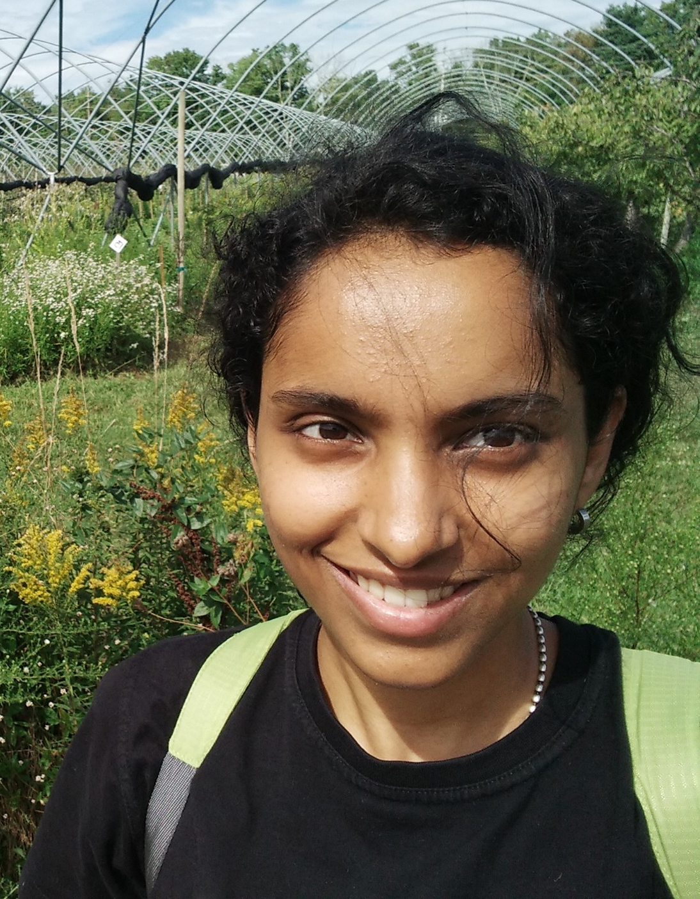
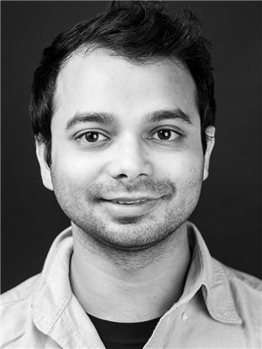
Fourier Growth of Communication Protocols for XOR Functions
Kewen Wu (UC Berkeley)
Uma Girish
Makrand Sinha
Avishay Tal
Princeton
UIUC
UC Berkeley

Slide 2
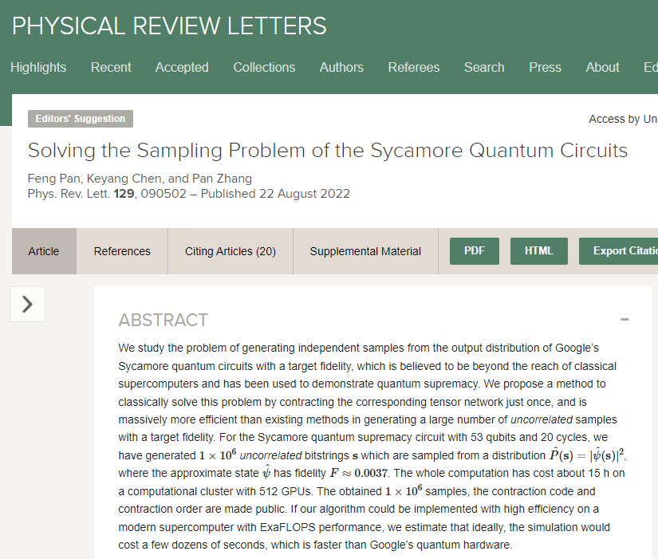
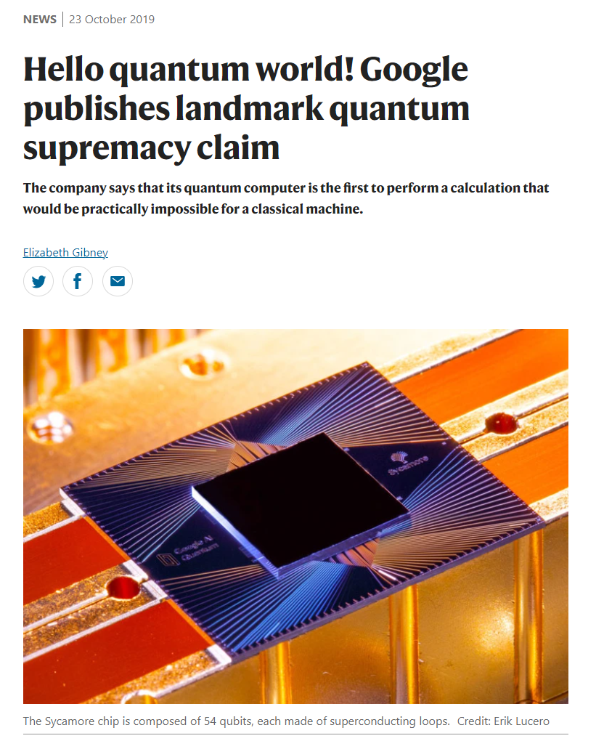
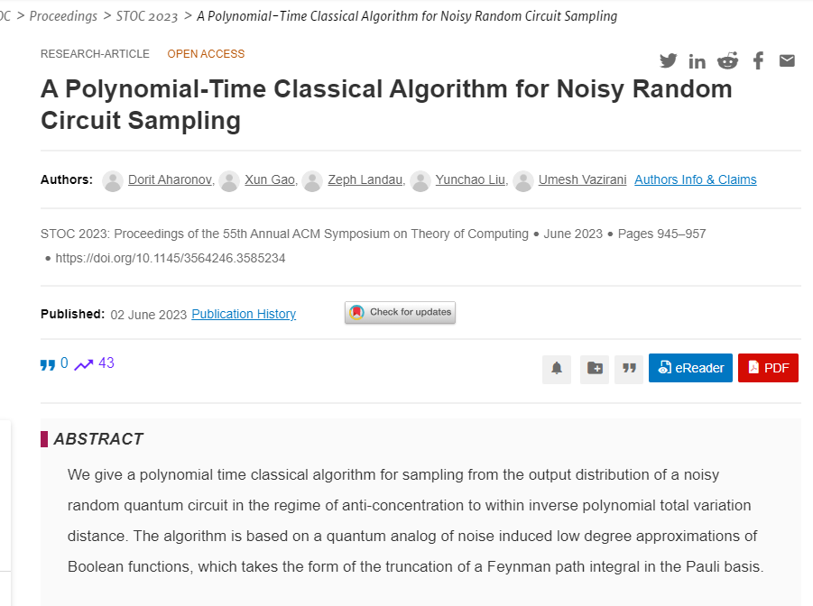
Quantum versus Classical
Quantum advantages
Shor’s factoring algorithm
Grover search
Fast Fourier transform
Solving linear equations
Heuristics are fragile and sometimes false
In 2019, Google claimed a quantum random circuit sampling task would take 10,000 years if ran classically
IBM soon questioned that a classical supercomputer can simulate it in a few days
In 2022, Pan-Chen-Zhang showed that even a conventional computer can do the job
More recently, polytime classical algorithms are designed for any constant noise regime by Aharonov-Gao-Landau-Liu-Vazirani
Assume factoring is classically hard
Quadratic speedup
Require quantum input / output

Slide 3
Provable Quantum Advantages
Unconditional on assumptions / heuristics
Exponential speedup from classical models
Classical inputs and outputs
Achievable in the query and communication models!

Slide 4
Query and Communication Models
Query model
Let $f:{\left\{±1\right\}}^{n}→\left\{±1\right\}$
Alice gets an input $x$
She wants to compute $f\left(x\right)$ with few #queries
Communication model
Let $F:{\left\{±1\right\}}^{n}×{\left\{±1\right\}}^{n}→\left\{±1\right\}$
Alice gets an input $x$
Bob gets an input $y$
They want to compute $F\left(x,y\right)$ with few #communications
For $x$ from some domain $A⊆{\left\{±1\right\}}^{n}$
For $x∈A,y∈B$
state $\sum_{i}{α_{i}\left|i\right\rangle }$
qubit $\left|b_{1}\right\rangle$
Index $i$
bit $b_{1}$ by $x$
bit $x_{i}$
$$x$$
bit $b_{2}$ by $b_{1},y$
$$y$$
state $\sum_{i}{α_{i}x_{i}\left|i\right\rangle }$
qubit $\left|b_{2}\right\rangle$
public randomness
shared entanglement

Slide 5
A General Recipe
$k=2$: The correlation (inner product) between
the first half of the input,
and the Fourier transform of the second half.
$k$-fold Fourier Correlation Problem ($k$-Forr) [Aaronson-Ambainis’18]
Efficiently computable by $⌈k/2⌉$ quantum queries
Complete problem for Bounded-Error Quantum Polynomial-Time (BQP)
Fourier-sparse functions cannot approximate $k$-Forr
[Raz-Tal’19, Bansal-Sinha’20, Girish-Raz-Tal’21]
Separating class $C_{1}$ from class $C_{2}$
Show $C_{1}$ efficiently computes $k$-Forr (or its variants)
Show functions in $C_{2}$ are all Fourier-sparse
Usually easy
We use XOR-lifted 2-Forr for communication model
Analysis on classical models

Slide 6
Boolean Functions and Fourier Growth
$\left[±1\right]$ is $\left[−1,1\right]$
Boolean function $f:{\left\{±1\right\}}^{n}→\left[±1\right]$
Fourier characters $x_{S}=\prod_{i∈S}{x_{i}}$ for each $S⊆\left[n\right]$
Fourier coefficients $\hat{f}\left(S\right)=E\left[f\left(x\right)⋅x_{S}\right]$ for each $S⊆\left[n\right]$
Fourier representation $f\left(x\right)=\sum_{S}{\hat{f}\left(S\right)⋅x_{S}}$
For deg-$d$ polys over $F_{2}$, it is conjectured $L_{ℓ}≲d^{ℓ}$.
Only $ℓ=1$ is verified, and the best bound for $ℓ≥2$ is still $≈2^{d⋅ℓ}$.
If true, even for $ℓ=2$, it implies major breakthrough in circuit lower bounds.
Highly nontrivial even for small levels
Level-$ℓ$ Fourier growth
$$L_{ℓ}\left(f\right)=\sum_{S:\left|S\right|=ℓ}{\left|\hat{f}\left(S\right)\right|}$$
$ℓ=1$: coin theorems
$ℓ=2$: pseudorandom generators (PRG), separations in circuit / communication complexity
Higher $ℓ$’s: hardness for $k\text{-}\text{Forr}$, better PRGs, expander random walks, learning algorithms
Fourier-sparse: $L_{ℓ}\left(f\right)$ is small for a range of $ℓ$
Established for DNFs/CNFs, ${AC}^{0}$ circuits, (parity) decision trees, read-once branching programs, …

Slide 7
XOR Functions and XOR Fibers
Let $g:Σ×Σ→\left\{±1\right\}$ be a two-party gadget function
Lifting query to communication
Let $f:{\left\{±1\right\}}^{n}→\left[±1\right]$ be a one-party function
Define $f_{↑g}:Σ^{n}×Σ^{n}→\left[±1\right]$as the two-party lifted function
$$f_{↑g}\left(x_{1}, …, x_{n},y_{1},…, y_{n}\right)=f\left(g\left(x_{1},y_{1}\right),…,g\left(x_{n},y_{n}\right)\right)$$
XOR functions: $f_{↑XOR}$
$XOR:{\left\{±1\right\}}^{2}→\left\{±1\right\}$ with $XOR\left(a,b\right)=ab$
${\left(f_{↑g}\right)}_{↓g}≡f$
but ${\left(F_{↓g}\right)}_{↑g}≠F$
Bring communication back to query
Let $F:Σ^{n}×Σ^{n}→\left[±1\right]$ be a two-party function
Define $F_{↓g}:{\left\{±1\right\}}^{n}→[±1]$ as the one-party fiber function
$$F_{↓g}\left(z_{1},…,z_{n}\right)=E_{x,y}\left[F\left(x_{1},…,x_{n},y_{1},…,y_{n}\right)∣g\left(x_{i},y_{i}\right)=z_{i} ∀i\right]$$
XOR fiber: $F_{↓XOR}$

Slide 8
Our Results
Tight up to constants
Let $F$ be a two-party function with $c$ bits of communication
Then $L_{1}\left(F_{↓XOR}\right)≲\sqrt{c}$ and $L_{2}\left(F_{↓XOR}\right)≲c^{1.5}$
Improving previous $L_{1}\left(F_{↓XOR}\right)≲c$ and $L_{2}\left(F_{↓XOR}\right)≲c^{2}$ [Girish-Raz-Tal’21]
$L_{ℓ}\left(F_{↓XOR}\right)≲c^{ℓ}$ can be deduced from previous works
Our analysis essentially saves a $\sqrt{c}$ for all levels
For general gadget $g:Σ×Σ→\left\{±1\right\}$:
$$L_{ℓ}\left(F_{↓g}\right)∈L_{ℓ}\left(F_{↓XOR}\right)⋅{\left|Σ\right|}^{±ℓ}$$
Conjecture: $L_{2}\left(F_{↓XOR}\right)≲c$ and in general, $L_{ℓ}\left(F_{↓XOR}\right)≲c^{ℓ/2}$
Such bounds are known for weaker models like (parity) decision trees [Tal’20, Sherstov-Storozhenko-Wu’21, Girish-Tal-W.’21]
Query-to-communication lifting with polylog-sized gadgets would imply the conjecture
Require lifting in the sense of the fiber function
State-of-the-art results require poly size [Chattopadhyay-Filmus-Koroth-Meir-Pitassi’19, Göös-Pitassi-Watson’20]

Slide 9
Applications
Strongest classical communication
Communication separations
${2\text{-}\text{Forr}}_{↑XOR}$ requires randomized communication $\tilde{Ω}\left(n^{1/3}\right)$
Improving $\tilde{Ω}\left(n^{1/4}\right)$ in [Girish-Raz-Tal’21]
Solvable in quantum simultaneous model with $polylog n$-qubit communication and entanglement
And the parties have efficient quantum circuits
Coin theorems and Gap-Hamming
The XOR-fiber of any $c$-bit protocol distinguishes $p$-biased and unbiased coins with advantage $≲p\sqrt{c}$
Distinguishing if $x,y$ have Hamming distance $≤n/2−\sqrt{n}$ or $≥n/2+\sqrt{n}$ needs randomized communication $Ω\left(n\right)$ [Chakrabarti-Regev’12, Sherstov’12, Vidick’12, Rao-Yehudayoff’22]
`Weakest’ quantum communication
Query-to-communication lifting theorems usually result in quantum two-way communication
Conceptually simpler perspective:
Gap-Hamming is essentially the XOR-lift of Majority
Majority has large level-1 Fourier growth, unlike XOR-fibers
$polylog n$-vs- $\sqrt{n}$ separations exist without efficiency requirement [Gavinsky’20]

Slide 10
Overview for Level-1 Bounds
Goal: $L_{1}\left(F_{↓XOR}\right)≲\sqrt{c}$
A martingale perspective on the Fourier growth [Girish-Tal-W.’21]
Fourier growth $⇒$ quadratic variation $⇒$ step sizes and #steps
Bounding step sizes
Additional communications required
Orthogonalization steps to zero out future correlations
Cleanup steps to preserve space isoperimetry [Girish-Tal-W.’21]
Leap from discrete to continuous
Communication bits $⇒$ sending reals
Bounding #steps
Boolean inputs $⇒$ Gaussian inputs
Concentration from sum of squares of adaptively chosen Gaussians
Putting together by hypercontractivity [Girish-Raz-Tal’21]
Communication from projections
Projected Gaussian is still Gaussian

Slide 11
Martingale Perspective
Goal: $L_{1}\left(F_{↓XOR}\right)≲\sqrt{c}$
Recall that $F:{\left\{±1\right\}}^{n}×{\left\{±1\right\}}^{n}→\left\{±1\right\}$ and
$$F_{↓XOR}\left(z_{1},….,z_{n}\right)=E_{x,y}\left[F\left(x_{1}, …,x_{n},y_{1},…,y_{n}\right)∣x_{i}y_{i}≡z_{i}\right]$$
Protocol of $F$
Alice
$$L_{1}\left(F_{↓XOR}\right)$$
$=\sum_{i}{\left|\hat{F_{↓XOR}} \left(i\right)\right|}$
$=\sum{E_{z}\left[F_{↓XOR}\left(z\right)⋅z_{i}\right]}$
$=\sum{E_{x,y}\left[F\left(x,y\right)⋅x_{i}y_{i}\right]}$
$=E_{x,y}\left[F\left(x,y\right)⋅\sum_{i}{x_{i}y_{i}}\right]$
$=E_{leaf ℓ}\left[F\left(ℓ\right)⋅\sum_{i}{E_{x,y}\left[x_{i}y_{i}∣ℓ\right]}\right]$
$=E_{leaf ℓ}\left[F\left(ℓ\right)⋅\sum_{i}{E_{x}\left[x_{i}∣ℓ\right]E_{y}\left[y_{i}∣ℓ\right]}\right]$
$≤E_{leaf ℓ}\left[\left|\sum_{i}{E_{x}\left[x_{i}∣ℓ\right]E_{y}\left[y_{i}∣ℓ\right]}\right|\right]$
$$0$$
$$1$$
Assume signs are +1’s for simplicity
Bob
$$0$$
$$1$$
$$0$$
$$1$$
Depth $c$
Leaf fixes output
Alice
Communication rectangle property
$$⋯⋯⋯⋯$$
$$⋯⋯$$
Leaf

Slide 12
Martingale Perspective
Protocol of $F$
$L_{1}\left(F_{↓XOR}\right)≤E_{leaf ℓ}\left[\left|\sum_{i}{E_{x}\left[x_{i}∣ℓ\right]E_{y}\left[y_{i}∣ℓ\right]}\right|\right]$
Alice
$$0$$
$$1$$
Define $ℓ_{i}$ as the $i$-th node from root to leaf $ℓ$
Bob
$=E_{ℓ}\left[\left|\sum_{i}{E_{x}\left[x_{i}∣ℓ_{c}\right]E_{y}\left[y_{i}∣ℓ_{c}\right]}\right|\right]$
$$0$$
$$1$$
$$0$$
$$1$$
$$c$$
Define $X_{i}$ be Alice’s possible inputs reaching $ℓ_{i}$
$Y_{i}$ be Bob’s possible inputs reaching $ℓ_{i}$
Alice
$$⋯⋯⋯⋯$$
$=E_{ℓ}\left[\left|\sum_{i}{E_{x}\left[x_{i}∣X_{c}\right]E_{y}\left[y_{i}∣Y_{c}\right]}\right|\right]$
$$⋯⋯$$
Define $μ\left(X_{i}\right)=E_{x}\left[x∣X_{i}\right]$ be the center of $X_{i}$
$μ\left(Y_{i}\right)=E_{y}\left[y∣Y_{i}\right]$ be the center of $Y_{i}$
Leaf
At $ℓ_{i−1}$ if Alice speaks and proceeds to $ℓ_{i}$
Then $Y_{i}=Y_{i−1}$ and $E\left[μ\left(X_{i}\right)\right]=μ\left(X_{i−1}\right)$
$⇒Δ_{i}=\left\langle μ\left(X_{i}\right)−μ\left(X_{i−1}\right),μ\left(Y_{i−1}\right)\right\rangle$ is mean-zero
$⇒ \left\{Z_{i}\right\}$ is a martingale
$=E_{ℓ}\left[\left|\left\langle μ\left(X_{c}\right),μ\left(Y_{c}\right)\right\rangle \right|\right]$
Define $Z_{i}=\left\langle μ\left(X_{i}\right),μ\left(Y_{i}\right)\right\rangle$ and $Δ_{i}=Z_{i}−Z_{i−1}$
$=E_{ℓ}\left[\left|Z_{c}\right|\right]=E_{ℓ}\left[\left|\sum_{i}{Δ_{i}}\right|\right]$
Quadratic variation
$≤\sqrt{E_{ℓ}\left[\sum_{i}{Δ_{i}^{2}}\right]}$

Slide 13
Overview for Level-1 Bounds
Goal: $L_{1}\left(F_{↓XOR}\right)≲\sqrt{c}$
Martingale perspective
Bounding step sizes
Additional communications required
Orthogonalization steps to zero out future correlations
Cleanup steps to preserve space isoperimetry [Girish-Tal-W.’21]
Leap from discrete to continuous
Communication bits $⇒$ sending reals
Bounding #steps
Boolean inputs $⇒$ Gaussian inputs
Concentration from sum of squares of adaptively chosen Gaussians
Putting together by hypercontractivity [Girish-Raz-Tal’21]
$$L_{1}\left(F_{↓XOR}\right)≤\sqrt{E\left[∑Δ_{i}^{2}\right]}$$
Communication from projections
Projected Gaussian is still Gaussian

Slide 14
Orthogonalization
$Δ_{i}=Z_{i}−Z_{i−1}$
$Z_{i}=\left\langle μ\left(X_{i}\right),μ\left(Y_{i}\right)\right\rangle$
$ℓ_{i}$ is the $i$-th step in a protocol random walk
$μ\left(X_{i}\right)=E_{x}\left[x∣X_{i}\right]$ is Alice’s center of mass
$μ\left(Y_{i}\right)=E_{y}\left[y∣Y_{i}\right]$ is Bob’s center of mass
$$L_{1}\left(F_{↓XOR}\right)≤\sqrt{E\left[∑Δ_{i}^{2}\right]}$$
If at $ℓ_{i−1}$ Alice speaks, then $Y_{i}=Y_{i−1}, E\left[μ\left(X_{i}\right)\right]=μ\left(X_{i−1}\right),$ and
$$Δ_{i}=\left\langle μ\left(X_{i}\right)−μ\left(X_{i−1}\right),μ\left(Y_{i−1}\right)\right\rangle$$
Ideally we want $Δ_{i}=0$
$μ\left(X_{i}\right)−μ\left(X_{i−1}\right)$ to be orthogonal to $μ\left(Y_{i−1}\right)$
Since $X_{i}$ depends on Alice’s arbitrary message
$X_{i−1}$ lies in an affine shift of the orthogonal complement of $μ\left(Y_{i−1}\right)$
$⇔$ $\left\langle x,μ\left(Y_{i−1}\right)\right\rangle$ is fixed for all $x∈X_{i−1}$
For $Δ_{i}$, we have
$E\left[Δ_{i}^{2} ∣ ℓ_{i−1}\right]$
$=E\left[{\left\langle μ\left(X_{i}\right)−μ\left(X_{i−1}\right),μ\left(Y_{i−1}\right)\right\rangle }^{2}∣ℓ_{i−1}\right]$
$=E\left[{\left\langle E\left[x∣X_{i}\right]−μ\left(X_{i−1}\right),μ\left(Y_{i−1}\right)\right\rangle }^{2}∣ℓ_{i−1}\right]$
$=E\left[E\left[{\left\langle x−μ\left(X_{i−1}\right),μ\left(Y_{i−1}\right)\right\rangle }^{2}∣X_{i}\right]∣ℓ_{i−1}\right]$
$=E\left[{\left\langle x−μ\left(X_{i−1}\right),μ\left(Y_{i−1}\right)\right\rangle }^{2}∣ℓ_{i−1}\right]$
$=Var\left[\left\langle x,μ\left(Y_{i−1}\right)\right\rangle ∣ℓ_{i−1}\right]$
Orthogonalization step:
Before Alice’s original communication, she sends $\left\langle x,μ\left(Y_{i−1}\right)\right\rangle$ to Bob
Her actual input
Pro
Before Bob’s turn, any message sent by Alice contributes zero
Con
Require real-valued communication
But only $c$ rounds in total, and martingale property still holds
Goal: Bound this
$Δ_{i+1}=Δ_{i+2}=⋯=0$ if Alice continues sending messages
Truncation necessarily leads to $\log{n}$ blow-up for precision control

Slide 15
$λ$-Clean
$Δ_{i}=Z_{i}−Z_{i−1}$
$Z_{i}=\left\langle μ\left(X_{i}\right),μ\left(Y_{i}\right)\right\rangle$
$ℓ_{i}$ is the $i$-th step in a protocol random walk
$μ\left(X_{i}\right)=E_{x}\left[x∣X_{i}\right]$ is Alice’s center of mass
$μ\left(Y_{i}\right)=E_{y}\left[y∣Y_{i}\right]$ is Bob’s center of mass
$$L_{1}\left(F_{↓XOR}\right)≤\sqrt{E\left[∑Δ_{i}^{2}\right]}$$
Upon Alice’s orthogonalization step at time $i$, we have
$$E\left[Δ_{i}^{2} ∣ ℓ_{i−1}\right]=Var\left[\left\langle x,μ\left(Y_{i−1}\right)\right\rangle ∣ℓ_{i−1}\right]$$
Let $i′<i$ be her last orthogonalization step, sending $\left\langle x,μ\left(Y_{i^{′}−1}\right)\right\rangle$
Any $x∈X_{i−1}⊆X_{i^{′}}$ has $\left\langle x,μ\left(Y_{i^{′}−1}\right)\right\rangle$ fixed already
Thus
$$E\left[Δ_{i}^{2} ∣ ℓ_{i−1}\right]=Var\left[\left\langle x,μ\left(Y_{i−1}\right)−μ\left(Y_{i^{′}−1}\right)\right\rangle ∣ℓ_{i−1}\right]$$
If $x∼X_{i}$is $λ$-clean for all $i$, then
Alice’s contribution to $E\left[∑Δ_{i}^{2}\right]$
$≤λ⋅E\left[∑{\left|μ\left(Y_{i−1}\right)−μ(Y_{i^{′}−1})\right|}_{2}^{2}\right]$
$=λ⋅E\left[{\left|μ\left(Y_{2c−1}\right)\right|}_{2}^{2}\right]$
Some direction
Quadratic variation
Not elongated in any direction
$c$ original communication
+
$c$ orthogonalization steps
A random vector $w$ is $λ$-clean:
${Var}_{w}\left[\left\langle w,v\right\rangle \right]≤λ$ for all $v$ of unit length
If $x∼X_{i−1}$ is $λ$-clean, then
$$E\left[Δ_{i}^{2} ∣ ℓ_{i−1}\right]≤λ⋅E\left[{\left|μ\left(Y_{i−1}\right)−μ\left(Y_{i^{′}−1}\right)\right|}_{2}^{2}\right]$$
Goal: Preserve $λ$-clean

Slide 16
Cleanup
$Δ_{i}=Z_{i}−Z_{i−1}$
$Z_{i}=\left\langle μ\left(X_{i}\right),μ\left(Y_{i}\right)\right\rangle$
$ℓ_{i}$ is the $i$-th step in a protocol random walk
$μ\left(X_{i}\right)=E_{x}\left[x∣X_{i}\right]$ is Alice’s center of mass
$μ\left(Y_{i}\right)=E_{y}\left[y∣Y_{i}\right]$ is Bob’s center of mass
$$L_{1}\left(F_{↓XOR}\right)≤\sqrt{E\left[∑Δ_{i}^{2}\right]}$$
A random vector $w$ is $λ$-clean:
${Var}_{w}\left[\left\langle w,v\right\rangle \right]≤λ$ for all $v$ of unit length
Her actual input
To maintain $λ$-clean property
While exist a witness $v$ for $x∼X_{i}$, Alice sends to Bob $\left\langle x,v\right\rangle$
This partitions $X_{i}$ into slices orthogonal to $v$
$⇒$ $Var\left[\left\langle x,v\right\rangle ∣X_{j}\right]≡0$ for all $j>i$
Original Alice’s execution at time $i$:
Send a bit $b_{i}$ based on $x$ and history
Pros:
$E\left[∑Δ_{i}^{2}\right]≤λ⋅E\left[{\left|μ\left(X_{D−1}\right)\right|}_{2}^{2}+{\left|μ\left(Y_{D−1}\right)\right|}_{2}^{2}\right]$
where $D$ is the depth of a random leaf in the new protocol
Cons:
Require real-valued communication
More communication rounds $D≫c$
Current Alice’s execution at time $i$:
Send $\left\langle x,μ\left(Y_{i−1}\right)\right\rangle$
Send the bit $b_{i}$
While exist a non-$λ$-clean witness $v$, send $⟨x,v⟩$
Orthogonalization
Cleanup
Projections

Slide 17
Overview for Level-1 Bounds
Goal: $L_{1}\left(F_{↓XOR}\right)≲\sqrt{c}$
Martingale perspective
Bounding step sizes
Bounding #steps
Boolean inputs $⇒$ Gaussian inputs
Concentration from sum of squares of adaptively chosen Gaussians
Putting together by hypercontractivity [Girish-Raz-Tal’21]
$$L_{1}\left(F_{↓XOR}\right)≤\sqrt{E\left[∑Δ_{i}^{2}\right]}$$
$$E\left[∑Δ_{i}^{2}\right]≤λ⋅E\left[{\left|μ\left(X_{D−1}\right)\right|}_{2}^{2}+{\left|μ\left(Y_{D−1}\right)\right|}_{2}^{2}\right]$$
where $D$ is the depth of a random leaf with orthogonalization and cleanup steps
Projected Gaussian is still Gaussian

Slide 18
Gaussian Inputs
Modified Alice’s execution in one round:
Send $\left\langle x,μ\left(Y\right)\right\rangle$
Send the original communication bit
While exist a non-$λ$-clean witness $v$ for $x∼X$, send $⟨x,v⟩$
$c$ in total
Distributions conditioned on linear projections?
Projection onto Bob’s center of mass
#projections
Projection onto non-$λ$-clean directions
Switch from Boolean to Gaussians
Input:
${x∼\left\{±1\right\}}^{n}$ $⇒$ $x∼N{\left(0,1\right)}^{n}$
Rectangle:
$X⊆{\left\{±1\right\}}^{n}$ $⇒$ $X⊆R^{n}$
Center of mass:
$μ\left(X\right)=E\left[x∣x∼unif(X)\right]$ $⇒$ $μ\left(X\right)=E\left[x∣x∼γ(X)\right]$
Bit-valued communication:
depends on $x$ and history bits $⇒$ depends on orthant of $x$ and history bits
Real-valued communication:
Sending projected value as real numbers
$λ$-clean:
$x∼unif(X)$ $⇒$ $x∼γ(X)$
Martingale analysis still holds
+
Fourier growth under Gaussians $≈$ Fourier growth under Booleans
Gaussian measure

Slide 19
Depth Analysis
Modified Alice’s execution in one round:
Send $\left\langle x,μ\left(Y\right)\right\rangle$
Send the original communication bit
While exist a non-$λ$-clean witness $v$ for $x∼X$, send $⟨x,v⟩$
A random vector $w$ is $λ$-clean:
${Var}_{w}\left[\left\langle w,v\right\rangle \right]≤λ$ for all unit $v$
Claim: If $λ≳1,$ then for typical $X$, we have $t≲c$
$X$ has Gaussian measure $≈2^{−c}$
Proof: Consider potential function
$$P\left(x\right)=∑{\left\langle x,v_{i}\right\rangle }^{2}$$
Since $v$’s are fixed, if $x∼N{\left(0,1\right)}^{n}$ then $P\left(x\right)∼χ^{2}\left(t\right)$ and
$$Pr\left[P\left(x\right)≥r\right]≲e^{−r} ∀r≥t$$
Hence
$$Pr\left[P\left(x\right)≥r∣x∼γ(X)\right]≲e^{−r}⋅2^{c} ∀r≥t$$
After Integration, we get
$$E\left[P\left(x\right)∣x∼γ(X)\right]≲t+c$$
However, by the choice of $v$’s, we have
$$E\left[{\left\langle x,v_{i}\right\rangle }^{2}∣x∼γ(X)\right]≥Var\left[\left\langle x,v_{i}\right\rangle ∣x∼γ(X)\right]>λ$$
Thus, we also have
$$E\left[P\left(x\right)∣x∼γ(X)\right]>λ⋅t$$
Rearranging gives $t≲c$ when $λ$ sufficiently large
Nonadaptive Setting
Alice first sends $c$ bits and obtains space $X⊆R^{n}$
Then find unit vector $v_{1},…, v_{t}$ orthogonal to each other and
$$Var\left[\left\langle x,v_{i}\right\rangle ∣x∼γ(X)\right]>λ$$
Finally send projections $\left\langle x,v_{1}\right\rangle ,…,\left\langle x,v_{t}\right\rangle$
Implicit in works on Gap-Hamming [Chakrabarti-Regev’12, Vidick’12]
But insufficient for us
Bits and projections are interlaced
Projections adaptively depends on previous bits and projections
Still, by carefully conditioning on bit communications we can show
If $λ≳1,$ then $E\left[t\right]≲c$,
where $t=$ #projections in our adaptive setting
Actual depth
$D=t+c$
If $λ≳1,$ then $E\left[D\right]≲c$

Slide 20
Overview for Level-1 Bounds
Goal: $L_{1}\left(F_{↓XOR}\right)≲\sqrt{c}$
Martingale perspective
Bounding step sizes
Bounding #steps
Putting together by hypercontractivity [Girish-Raz-Tal’21]
$$L_{1}\left(F_{↓XOR}\right)≤\sqrt{E\left[∑Δ_{i}^{2}\right]}$$
$$E\left[∑Δ_{i}^{2}\right]≤λ⋅E\left[{\left|μ\left(X_{D−1}\right)\right|}_{2}^{2}+{\left|μ\left(Y_{D−1}\right)\right|}_{2}^{2}\right]$$
where $D$ is the depth of a random leaf with orthogonalization and cleanup steps
If $λ≳1,$ then $E\left[D\right]≲c$

Slide 21
Hypercontractivity
$$E\left[∑Δ_{i}^{2}\right]≤λ⋅E\left[{\left|μ\left(X_{D−1}\right)\right|}_{2}^{2}+{\left|μ\left(Y_{D−1}\right)\right|}_{2}^{2}\right]$$
Level-1 Inequality [Talagrand’86, Kahn-Kalai-Linial’88]
$$\sum_{i}{{\left(E\left[x_{i}∣x∼γ(X)\right]\right)}^{2}}≲\log{\frac{1}{γ(X)}}$$
Gaussian measure
$$E\left[{\left|μ\left(X_{D−1}\right)\right|}_{2}^{2}\right]=E\left[\sum{{\left(E\left[x_{i}∣x∼γ\left(X_{D−1}\right)\right]\right)}^{2}}\right]≲E\left[\log{\frac{1}{γ(X_{D−1})}}\right]$$
$≲E\left[D\right]$ in the Boolean communication setting
where typical $X_{D−1}$ has measure $≈2^{−D}$
Issue in Gaussian spaces:
$X_{D−1}$ is measure 0 due to projections
Fix:
Analyze projections and bit communications separately
$X_{D−1}$ lies in an affine Gaussian subspace due to projections
Where bit communication partitions it into $2^{c}$ parts
Essentially, we still have $E\left[{\left|μ\left(X_{D−1}\right)\right|}_{2}^{2}\right]≲E\left[D\right]$ and $E\left[{\left|μ\left(Y_{D−1}\right)\right|}_{2}^{2}\right]≲E\left[D\right]$

Slide 22
Overview for Level-1 Bounds
Goal: $L_{1}\left(F_{↓XOR}\right)≲\sqrt{c}$
Martingale perspective
Bounding step sizes
Bounding #steps
Putting together by hypercontractivity
$$L_{1}\left(F_{↓XOR}\right)≤\sqrt{E\left[∑Δ_{i}^{2}\right]}$$
$$E\left[∑Δ_{i}^{2}\right]≤λ⋅E\left[{\left|μ\left(X_{D−1}\right)\right|}_{2}^{2}+{\left|μ\left(Y_{D−1}\right)\right|}_{2}^{2}\right]$$
where $D$ is the depth of a random leaf with orthogonalization and cleanup steps
If $λ≳1,$ then $E\left[D\right]≲c$
$$E\left[{\left|μ\left(X_{D−1}\right)\right|}_{2}^{2}+{\left|μ\left(Y_{D−1}\right)\right|}_{2}^{2}\right]≲E\left[D\right]$$

Slide 23
Overview for Level-2 Bounds
$Δ_{i}=Z_{i}−Z_{i−1}$
$Z_{i}=\left\langle σ\left(X_{i}\right),σ\left(Y_{i}\right)⊙sgn\right\rangle$
$sgn∈{\left\{0,±1\right\}}^{n×n}$ is a zero-diagonal sign matrix
$σ\left(X_{i}\right)=E_{x}\left[xx^{⊤}∣X_{i}\right]$ is Alice’s correlation matrix
$σ\left(Y_{i}\right)=E_{y}\left[yy^{⊤}∣Y_{i}\right]$ is Bob’s correlation matrix
Goal: $L_{2}\left(F_{↓XOR}\right)≲c^{1.5}$
Martingale perspective
Bounding step sizes
Bounding #steps
Putting together by hypercontractivity
$$L_{2}\left(F_{↓XOR}\right)≤\sqrt{E\left[∑Δ_{i}^{2}\right]}$$
$λ$-clean:
${Var}_{w}\left[\left\langle ww^{⊤},V\right\rangle \right]≤λ$ for all unit zero-diagonal $V$
Orthogonalization: $\left\langle xx^{⊤},σ\left(Y\right)⊙sgn\right\rangle$
Cleanup: $⟨xx^{⊤},V⟩$
$$E\left[∑Δ_{i}^{2}\right]≤λ⋅E\left[{\left|σ\left(X_{D−1}\right)\right|}_{2}^{2}+{\left|σ\left(Y_{D−1}\right)\right|}_{2}^{2}\right]$$
Sending real values $⇒$ precision control via truncation
If $λ≳c,$ then $E\left[D^{2}\right]≲c^{2}$
$P\left(x\right)=∑{\left\langle x,v_{i}\right\rangle }^{2}$ $⇒$ $P\left(x\right)=∑{\left\langle xx^{⊤},V_{i}\right\rangle }^{2}$
Concentration of $χ^{2}$ distribution $⇒$ Hanson-Wright-type inequality
$$E\left[{\left|σ\left(X_{D−1}\right)\right|}_{2}^{2}+{\left|σ\left(Y_{D−1}\right)\right|}_{2}^{2}\right]≲E\left[D^{2}\right]$$
Level-1 inequality $⇒$ Level-2 inequality

Slide 24
Summary
Tight level-1 Fourier growth bounds for XOR-fibers
Improved level-2 Fourier growth bounds for XOR-fibers
Applications:
Quantum versus classical communication
Coin theorems and Gap-Hamming problems
Open directions:
$L_{2}\left(F_{↓XOR}\right)≲c$ and in general, $L_{ℓ}\left(F_{↓XOR}\right)≲c^{ℓ/2}$
Query-to-communication lifting with smaller gadgets
$$L_{1}\left(F_{↓XOR}\right)≲\sqrt{c}$$
$$L_{2}\left(F_{↓XOR}\right)≲c^{1.5}$$
Thank you!

